Slide 1


H2o Driverless AI

Slide 2





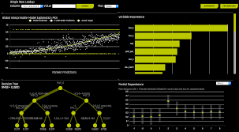
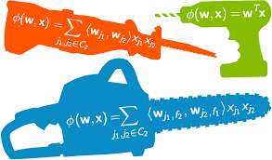

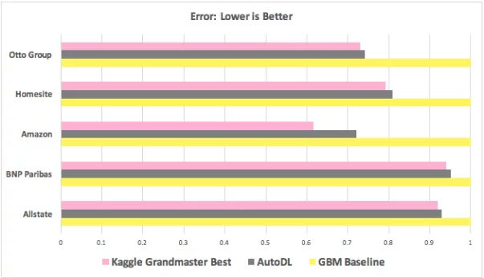


Overview
H2O Driverless AI is a high-performance, GPU-enabled, client-server application for the rapid development and deployment of state-of-the-art predictive analytics models.
Automates
MODEL TRAINING
Reads tabular data
(csv/S3 buckets)
FEATURE ENGINEERING
MLI
Highlights
BUSINESS USE CASES
MODELS
Common Regression
Binomial Classification
Multiclass Classification
Probability of default
Customer Churn
Fraud Detection
Campaign Response
KAGGLE – PERFORMANCE

Slide 3




Installing Driverless AI
General Requirements
Platforms
Min 10 GB Free disk space to run
At least 30GB or 10x your dataset size
CPU Memory – 64GB or more
Desktop – (Small sample sizes experimentation purposes only)
Server – Large scale deployment within org (Server setup required)
Cloud – AWS/Azure/Google Cloud
POV Exercise (1 month free trail license for driverless AI)
H2o AMI

Slide 4
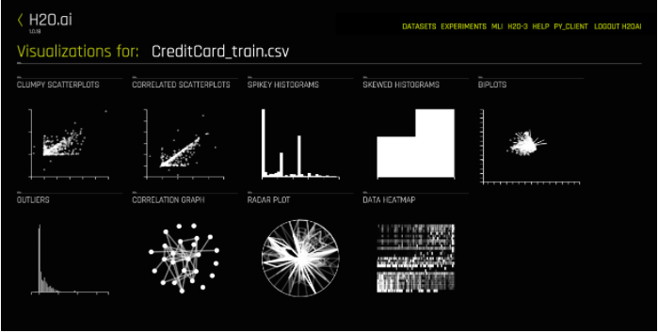
Visualizing Dataset
H2O Driverless AI provides Visualization page which shows all available graphs for the selected dataset
Scatter Plots
Histograms (Skewness/Spikey)
Outliers
Correlation/Network Graph
Radar Plot
Heat map

Slide 5





Running Experiments
Once the Training & Test data sets are loaded into driverless AI the below parameters are to be set to run the experiment.
Performance
Score
Dropped Columns
(Trans ID for eg)
Accuracy
(Input 1-10)
Time
(Input 1-10)
Interpretability
(Input 1-10)
Regression
GINI
R2
MSE
RMSE
RMSLE
RMSPE
MAE
MAPE
SMAPE
Classification
GINI
MCC
F05
F1
F2
Accuracy
Logloss
AUC
AUCPR
Features are engineered with proprietary stack of statistical models (linear, neural nets, clustering & dimensionality reduction models)
Parameter value determined by
Max Rows
Ensemble Level
Target transformation
Parameter tuning
Parameter value determined by
Relative time for completing experiment
Higher settings take longer
Iterations
Parameter value determined by
Feature selection strategy (>=6)
Feature Engg
Lesser Transformation with high input

Slide 6
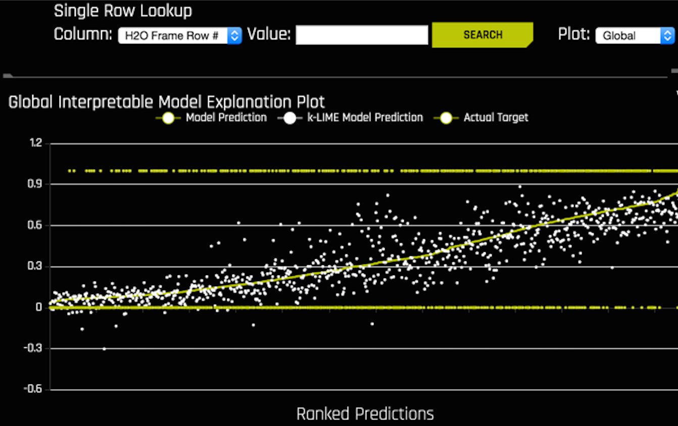
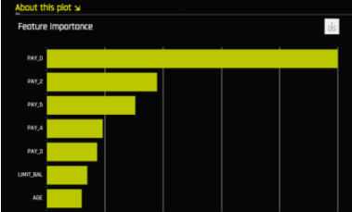
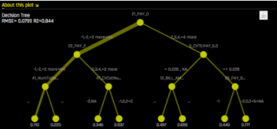





MLI
Driverless AI MLI (Machine learning interpretation) platform provides different types of insights and explanations regarding a model and its results
K-LIME Technique
Feature Importance
Decision Tree Surrogate Model
Score on a data set
Transform a dataset
Download predictions
(Train/Test datasets)
Python Scoring Pipeline
Logs capturing process from feature engineering to model building

Slide 7

POV RESULTS
COST: Open source
License: $40K/Year
(Only single user access)
COST: Open Source
<50$(Infra Cost)
Basic CART Model executed in R
Results from H20 Driverless AI
Results from xgboost
Performance
Test AUC: 71.6%
Performance
Test AUC: 92.07%
Performance
Test AUC: 92.8%
Speed
Feature Engineering: NA
Feature Selection: NA
Model Parameter Tuning: NA
Model Training: 8 Mins
Speed
Feature Engineering: 14 mins
Feature Selection: 2 mins
Model Parameter Tuning: 1 min
Model Training: 2 Mins
Speed
Feature Engineering: NA
Feature Selection: 2 Weeks
Model Parameter Tuning: 1 Week
Model Training: 12 Mins
Interpretability
Features/Models: Good
Interpretability
Features/Models: Average
Interpretability
Features/Models: Good

Slide 8
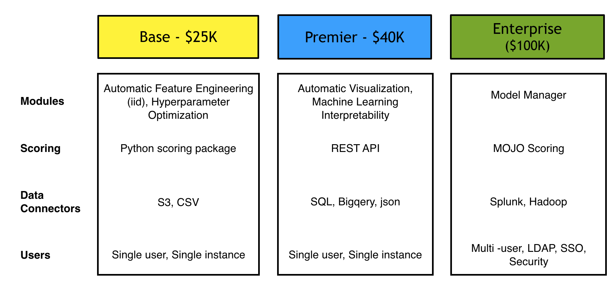
Pricing Options

Slide 9
Key Links
Documentation on H2o driverless AI: http://docs.h2o.ai/driverless-ai/latest-stable/docs/userguide/release_notes.html
DriverlessAI Webinars: https://webinar.com/channel/4a90aa11b48f4a5d8823ec924e7bd8cf
Feature Engineering by Dimitri Lago:
https://www.gotostage.com/channel/4a90aa11b48f4a5d8823ec924e7bd8cf/recording/6e1a607ad5cf4cb594be3ae4bccdbe14/watch?source=CHANNEL
Machine Learning Interpretability with Driverless AI with Patrick Hall:
https://www.gotostage.com/channel/4a90aa11b48f4a5d8823ec924e7bd8cf/recording/0fe74cb2de184f4ea5056b60a7c23472/watch?source=CHANNEL

Slide 10

Appendix

Slide 11

About Data
Transaction Data
147k observations & 218 variables
47k observations & 220 variables
Event Rate: 7%
Target Variable: P_BA2
#0s in P_BAD2: 136,736 (93%)
#1s in P_BAD2: 10,311 (7%)
Event Rate: 5%
Target Variable: P_BA2
#0s in P_BAD2: 41,150 (95%)
#1s in P_BAD2: 1,904 (5%)
Training and testing files were provided separately

Slide 12







Important Variables
SPARK BEYOND
H2O DRIVERLESS AI
8th Digit of IBAN
Date of Last Schufa variable
First Registration Date
Customer Wish Date
Provider To
Media Code
Delivery Service Provider
Risk-Index (Hardware)
Number of Schufa variables
Schufa Filter
2-digit code for Schufa variable
Product ID
Article Template ID
Place of Registration of Company(B2B etc..)
Request ID
Transaction ID
Application Score
CREDIT SCORE
SHOP ID
CAMPAIGN ID
ADDRESS
VERIFICATION
ORDER VALUE
AGE
GRADIENT BOOSTING
Schufa Credit Score
Schufa-Filter
Age of customer
External information: address verification
Flag: delivery address unequal to billing address
Sum of order value of basket case (Hardware only)
ProviderToRisk-Index Hardware
delivery service provider
8th digit of IBAN

Slide 13
GENERATED FEATURES
H2O DRIVERLESS AI
Index | Feature | Description | Relative Importance
1 | 201_NumCatTE_I_AB_SCHUFA_SCOREBEREICH_I_CS_M_TEXT_03__MO_2_I_CS_M_TEXT_06__MO_2_I_CS_TEXT_15_I_CS_TEXT_22_I_IRP_TOP_CLIENTTRANSACTIONID_O_CS_SIGNUM_08_0 | A transformation formed by grouping Schufa Credit Score, Reference Product , Article Template ID, Shop ID , Media Code of Campaign, Request ID and Address Verification flag is the variable with highest importance | 1.00
2 | 26_CV_TE_I_AB_SCHUFA_SCOREBEREICH_0 | Cross Validation Target Encoding of Schufa Credit Score | 0.20
3 | 73_CV_TE_I_CS_UNSNUM_11_0 | Cross Validation Target Encoding of Order Value in the Basket | 0.14
4 | 20_CV_TE_I_AB_SCHUFA_FILTEXTE_0 | Cross Validation Target Encoding of Schufa Filter | 0.13
5 | 37_CV_TE_I_CS_M_TEXT_06__MO_2_0 | Cross Validation Target Encoding of Article Template ID | 0.13
6 | 65_CV_TE_I_CS_TEXT_22_0 | Cross Validation Target Encoding of Media Code | 0.12
7 | 208_NumCatTE_I_AB_SCHUFA_MRK_CODE_I_AB_SCHUFA_SCOREBEREICH_I_CS_M_TEXT_02__MO_1_I_CS_M_TEXT_03__MO_2_I_CS_M_TEXT_06__MO_2_I_CS_TEXT_15_I_CS_TEXT_18_I_CS_TEXT_22_I_IRP_TOP_CLIENTTRANSACTIONID_O_CS_SIGNUM_08_O_OSC_0 | Numerical to Categorical Encoding of the following variables grouped – 2-Digit Schufa Code, Schufa Credit Score, Product ID, Reference Product, Article Template, Shop ID, Place of Registration, Media Code, Address Verification and Application Score | 0.11
8 | 207_NumCatTE_ALTER_ID_TRANSACTION_I_AB_SCHUFA_ANZ_MRK_I_AB_SCHUFA_SCOREBEREICH_I_CS_M_TEXT_02__MO_1_I_CS_TEXT_15_I_CS_UNSNUM_11_0 | Numerical to Categorical Encoding of the following variables grouped – Age, Transaction_ID, Number of Schufa Features, Schufa Credit Score, Product ID, Shop ID and Sum of Order Basket | 0.10
9 | 34_CV_TE_I_CS_M_TEXT_02__MO_1_0 | Cross Validation Target Encoding of Product ID | 0.07
10 | 60_CV_TE_I_CS_TEXT_15_0 | Cross Validation Target Encoding of Shop ID | 0.06

Slide 14
H2o Features Interpretability
H2O Driverless AI generated around 2200 features and selected around 220 features for the model with highest accuracy. Some of them are shown below
Feature 1*
Transformation : Numeric to Categorical Target Encoding
Interpretation : A transformation formed by grouping Schufa Credit Score, Reference Product , Article Template ID, Shop ID , Media Code of Campaign, Request ID and Address Verification flag
For Business Use: No
CV_TE_I_AB_SCHUFA_SCOREBEREICH
Transformation : Cross Validation Target Encoding
Interpretation : Transformation on Schufa Credit Score
For Business Use : No
CV_TE_I_CS_TEXT_22_0
Transformation : Cross Validation Target Encoding
Interpretation : Transformation on Media Code
For Business Use : No
CV_TE_I_CS_UNSNUM_11_0
Transformation : Cross Validation Target Encoding
Interpretation : Transformation on Order Value
For Business Use : No
CV_TE_I_CS_M_TEXT_06__MO_2_0
Transformation : Cross Validation Target Encoding
Interpretation : Transformation on Article Template ID
For Business Use : No
CV_TE_I_AB_SCHUFA_FILTEXTE_0
Transformation : Cross Validation Target Encoding
Interpretation : Transformation on Schufa Filter
For Business Use : No
Feature 7*
Transformation : Numeric to Categorical Target Encoding
Interpretation : Transformation on 2-Digit Schufa Code, Schufa Credit Score, Product ID, Reference Product, Article Template, Shop ID, Place of Registration, Media Code, Address Verification and Application Score
For Business Use : No
*Refer Appendix Slide # 16 for Feature Definitions

Slide 15
Feature Engineering
H2O driverless AI uses the following transformations on the datasets and generates new features
Target encoding methods
Cross Validation Target Encoding
Cross Validation Categorical to Numeric Encoding
Categorical Target Encoding
Numeric to Categorical Target Encoding Transformer
Cluster Target Encoding Transformer
Cluster Distance Transformer
Weight of Evidence
Numeric To Categorical Weight of Evidence Transformer
Filter Transformer – Counts of values in Numeric columns
Frequent Transformer – Counts of categorical values
Bulk Interactions Transformer – Arithmetic Operations on the numerical columns
Truncated SVD Numeric Transformer – Matrix based dimensionality reduction Method
Dates
Dates Transformer – Month, Year, Weekday etc..
Date Polar Transformer – Month in Year
Text
Text Transformer - term frequency–inverse document frequency/counts to assign weights to the word in the whole column

